Slide 1

Free School Meals – Schools update
System walkthrough/training
14th Jan 2026

Slide 2

Introductions:
Steve Basta & David Hall
DfE Colleagues
Notes:
Welcome to everyone, thanks for joining today.
Before we get started, a few housekeeping items
Accessibility – Click on 3 dots at the top and choose “captions on”
Comments and questions – Add to chat. Including option to up vote any questions which we will cover at the end.
Recording, Transcript and slides. – Available after call via schools’ bulletin and posted on the Herts Grid for learning.

Slide 3
AGENDA
01 | Purpose and objectives
02 | Recap of new FSM system
03 | Pending applications
04 | Processing applications/Eligibility
05 | Transitional protection update
06 | Summary

Slide 4
Training purpose and objectives
The aim of this training is to address matters schools raised at December drop-in sessions:
Schools have asked for the following guidance:
How to process a pending application
Determining eligible pupils (checking benefit status)
How to accept applications into their school
Archiving records, removing pupils from their lists

Slide 5
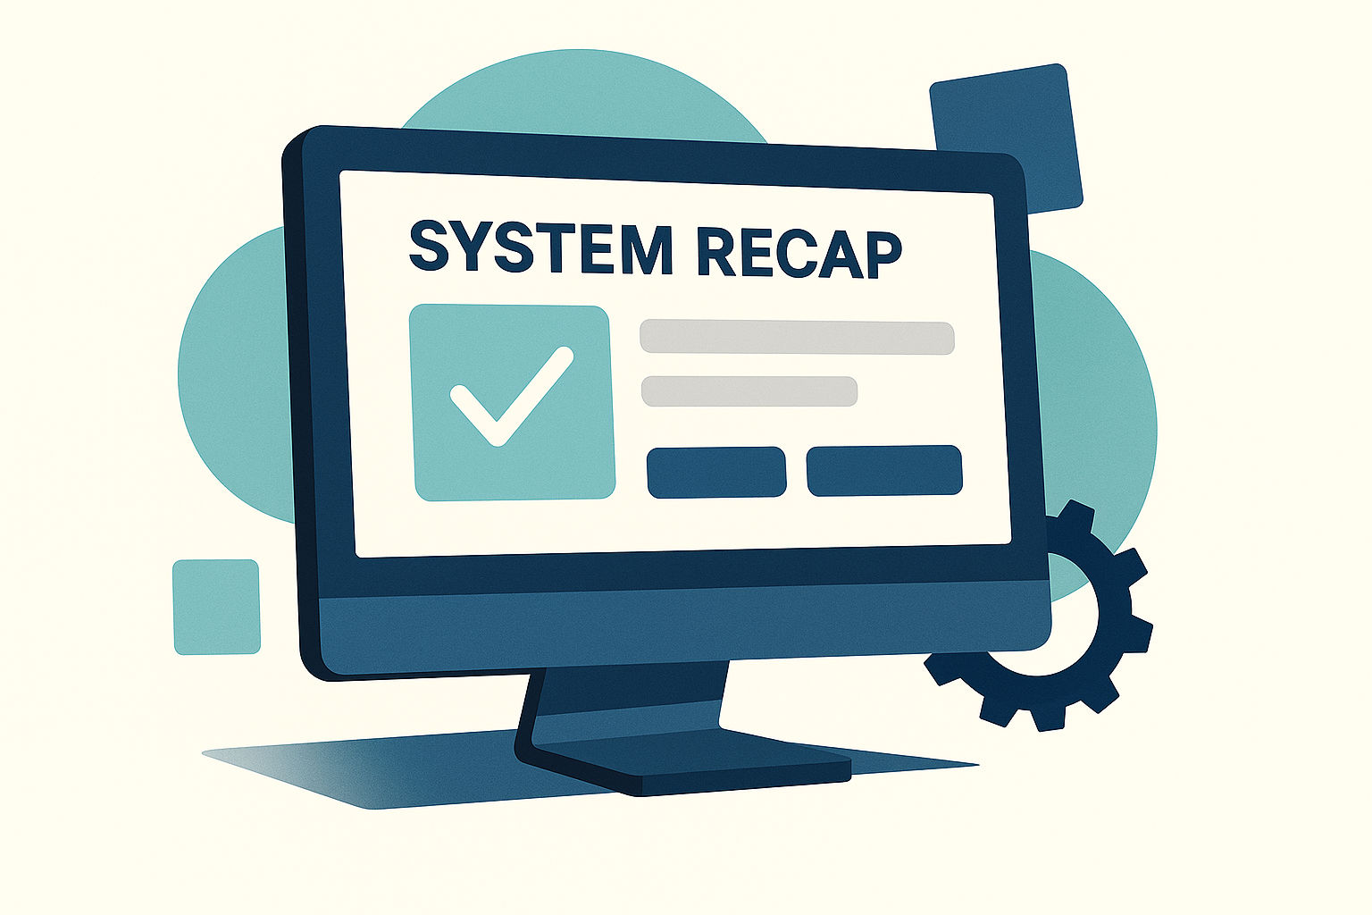

Slide 6
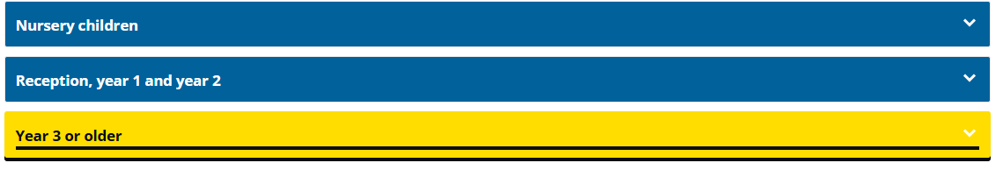
Applicant view – Parents & Carers
Applicants visit www.hertfordshire.gov.uk/freeschoolmeals
Choose child’s current age from drop down:
  Nursery, reception, Y1 and 2 – Universal infant free school meals – HCC still host this form. Info still on SOLERO list.
  Year 3 + = New DfE free school meals system

Slide 7
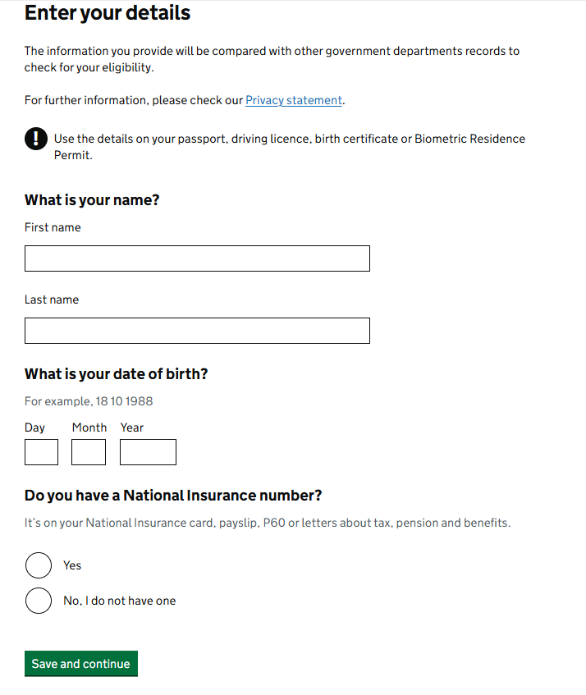
Applicant view – Parents & Carers
An entitlement “soft check” is done using applicant DOB, surname and NI Number.
Once parent submits, they are given a likely outcome (Eligible or not)
  Eligible – Applicant creates a gov account to complete full application and submit to relevant school. Mulitple applications can be made for multiple schools.
  Not eligible – Applicant can still submit if they have evidence to prove otherwise. Will be asked to upload proof for schools to review.
    NOTE – This is a very small % of applications, most will not apply if the soft check comes back as “not eligible”.

Slide 8
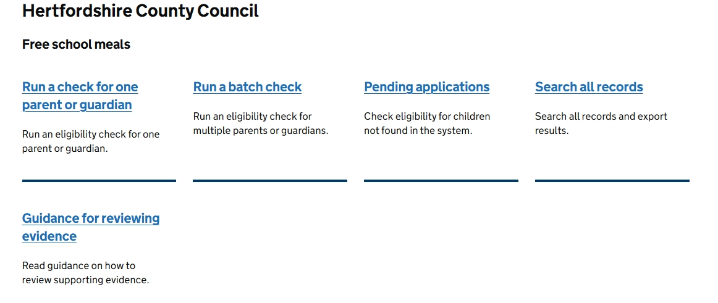

School dashboard:
Once logged in, there’s 4 options and an additional link to guidance docs and training materials schools can use to help navigate the system:
Notes:
Schools can run a check on behalf of a family by choosing the “Run a check for one parent or guardian”

Slide 9
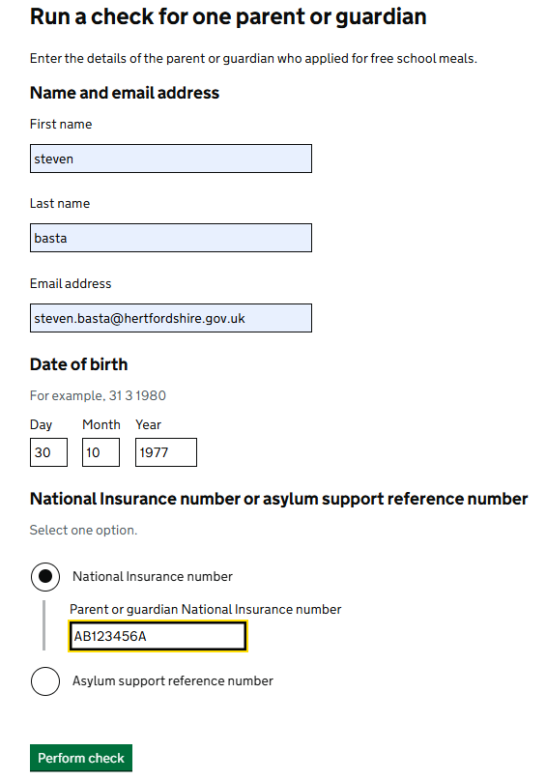
Run an eligibility check for one parent or guardian
Schools can either:
Signpost parents/carers to the website to apply themselves, or
Apply on their behalf (with consent)
Fill in all required fields and “perform a check”. This will check if the parent/carer is entitled.

Slide 10
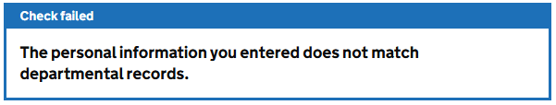
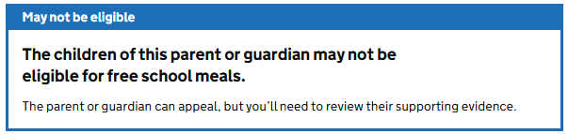
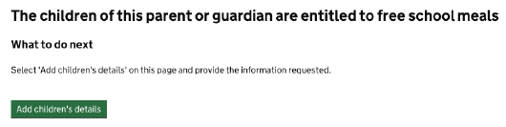
Soft check results:
Theres’ 3 outcomes/actions.
Check failed – Usually means the info provided (NI, Surname or DOB) doesn’t match. Check info and re-submit
May not be eligible – The system can’t find the parent/carer eligible. Can still apply and provide evidence for school to check. (Approx 7% total apps)
Eligible – System has found the match and shows eligible. School accepts

Slide 11
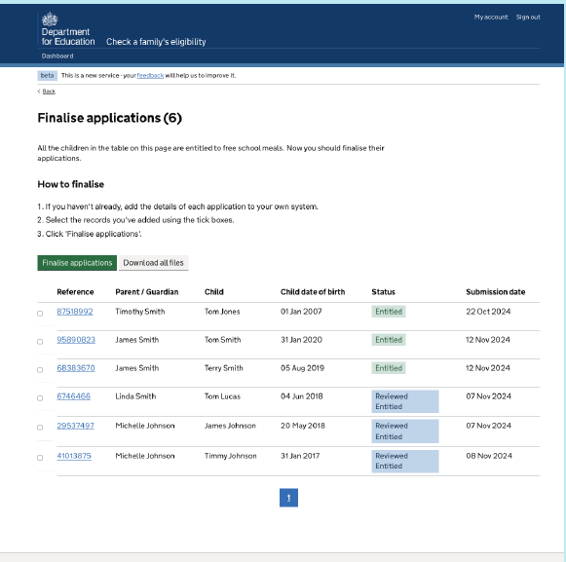
Accepting or finalising an application
You must always update your school’s system:
  On the finalise applications page:
  Add the details of each application into your internal school system
  Once complete return to the Finalise application page.

Slide 12
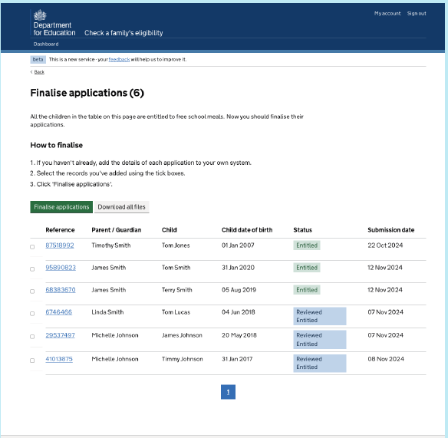
Accepting or finalising an application
Mark applications as complete
  Tick each application that you’ve added into your system.
  Click “Finalise application”

Slide 13





Status and their meanings
You will see the following status throughout the system.
Entitled; The application is eligible but waiting for you to add it to your records.
Receiving Entitlement: The entitlement has been added to your records/internal management information system.
Sent for review: The application is currently waiting for you to review the application and evidence.
Reviewed Entitled: You have reviewed the application and deemed it eligible.
Reviewed Not Entitled: You have reviewed the application but found it ineligible.

Slide 14

Processing a “pending application”.
Applications “sent for review” will appear in the “Pending applications section on the dashboard.

Slide 15

Processing a “pending application”.
The majority of applications will be approved by the system and show on your school list as
  The only action for these is to accept them onto your school following the process previously outlined
Approximately 7% of applications made will come back as “Sent for Review”.
This means the parent has applied, but the system has not found them to be entitled.
Parents can still submit an application with supporting evidence
When this happens schools will see an application showing in their list as “Sent for review” found in the “Pending applications” section of the dashboard.
It’s the schools responsibility to determine eligibility based on the evidence supplied.
Most applicants will provide Universal Credit proof as this is the most common benefit parents will be receiving.

Slide 16
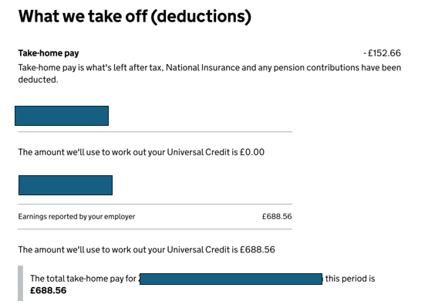

What evidence is accepted?
For universal credit – Applicant is eligible if their latest UC statement shows “total take-home pay” to be less than £616.67 for that month.
You can usually find this on page 2 of their UC statement.
UC statement must be from the month before the FSM application was made.
If statement shows previous month is over threshold £616.67, applicant may submit 2 further statements that run consecutively to the original month submitted eg Sep, Oct & Nov.
NOT ELIGIBLE!!

Slide 17
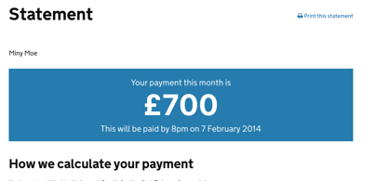

What evidence is accepted?
Newer style Universal Credit statements will have section in Blue box which can be taken as the “take home pay”
Here are 2 examples 1 “eligible” and 1 “not eligible”
Not eligible
Eligible

Slide 18
Who’s eligible and not – How it works.
Applicant can submit up to 3 months consecutive proof of Universal Credit.
Schools check month 1 statement first and apply the following rules.
  Month 1 statement (most recent) – Take home pay less than £616.67 = Eligible
  Month 1 statement (most recent) – Take home pay more than £616.67 = Not Eligible
If month 1 check is “not eligible”, follow next steps
Month 1 & 2 statements - Combined take home pay for the two months is less than £1,233.34 = Eligible
Month 1 & 2 statements - Combined take home pay for the two months is more than £1,233.34 = Not eligible
If month 1 & 2 check is “not eligible”, follow next steps
Month 1, 2 & 3 statements - Combined take home pay for the two months is less than £1,850 = Eligible
Month 1, 2 & 3 statements - Combined take home pay for the two months is more than £1,850 = Not eligible

Slide 19
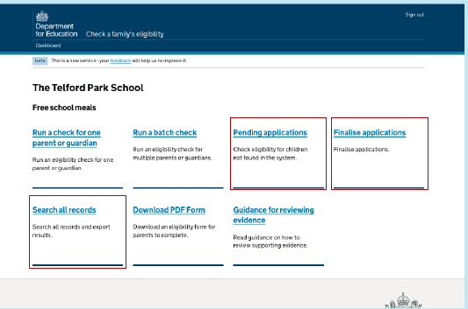
Archiving a record:
Process is covered in Section 9 of your ‘school walkthrough slides’ previously shared in school bulletin.
You can archive a single record from either of these sections
  ‘pending applications’
  ‘Finalise applications
  ‘Search all records’

Slide 20
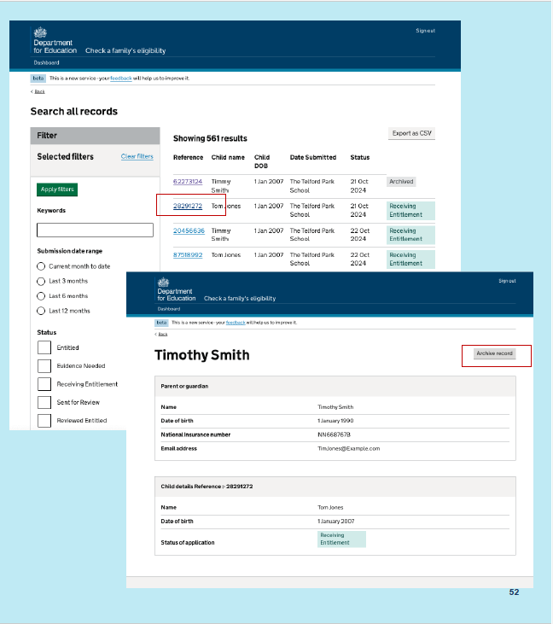
Archive a record:
Choose the record you’d like to archive
  Select the reference number for the individual you’d like to archive
  When in the record, click the ‘Archive record’ button

Slide 21
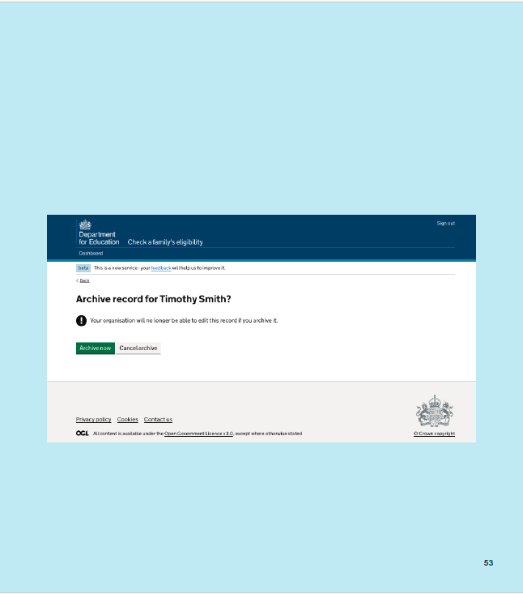
Archive a record:
Confirm you’d like to archive a record
  When you’re shown this question, you can ‘archive now’ if you’re sure, or ‘Cancel archive’ if you’ve made a mistake.

Slide 22
Transitional protection update:
  Transitional protection ends at the end of this academic year (25/26).
  From 26/27 onwards, applicants receiving any level of Universal Credit will be entitled to Free School Meals for their child. This means no checks on “monthly income”.
  Pupil premium claims will remain at the existing criteria. DfE are developing the Eligibility checking system to reflect both FSM and Pupil premium entitlement. More information to follow.
  A reminder, any pupil moving from year 2 to year 3 who was entitled (under low income) in year 2 will be entitled under the transitional protection rule until the end of this current academic year (25/26). Schools do not need to check proof of benefit for these pupils for this academic year.
  Schools will need to see evidence that the child was previously FSM, if this is supplied, schools can approve the application via the pending applications section.

Slide 23
Summary:
The majority of applications will be approved by the system without schools needing to check entitlement.
  Schools will only need to check benefit income until Sep 2026
Applications showing status – Schools need to accept onto their school to then show as on their list.
Schools will not be notified when new applications are received, it’s the schools’ responsibility to check their system regularly.
Applicants are only eligible if their Universal Credit shows a take home pay to be no more than:
  £616.67 for the month before the application or
  £1,233.34 previous 2 months statements or
  £1,850 previous 3 months statement.
Transitional protection - Ends in summer 2026. Further information to follow including renewals/rechecks

Slide 24
User research:
This is a new Free School Meals system.
The DfE continue to make development changes to enhance the user experience.
We would encourage schools to provide feedback to the DfE on ideas to make it even better.
The DfE will be providing an opportunity to schools to work with them.
Details will be provided in this chat and followed up in school bulletins.

Slide 25
Questions

