Slide 1
Free School Meals System - Launch
School drop-in session December 2025

Slide 2
SCHEDULE
01 | Introductions
02 | Project context
03 | System Demo
04 | Future development
05 | Q&A
06 | AOB

Slide 3

Introductions:
Steve Basta
David Hall
DfE colleagues

Slide 4
Context: Why are we changing systems?
HCC has hosted free school meals system for parents/carers to apply since 2008.
Customer Service Centre process applications (where system can’t determine entitlement)
Current Year 3+ free school meals system will no longer be technologically supported from March 2026.
Schools access application status via SOLERO

Slide 5
What were our options?
Exploring alternative system options
1. Complete re-build of current system on new platform
2. Procure new system supplier
Both options presented risk, both costly and uncertainty to provide assurance will meet all user needs (parents, schools and LA)

Slide 6
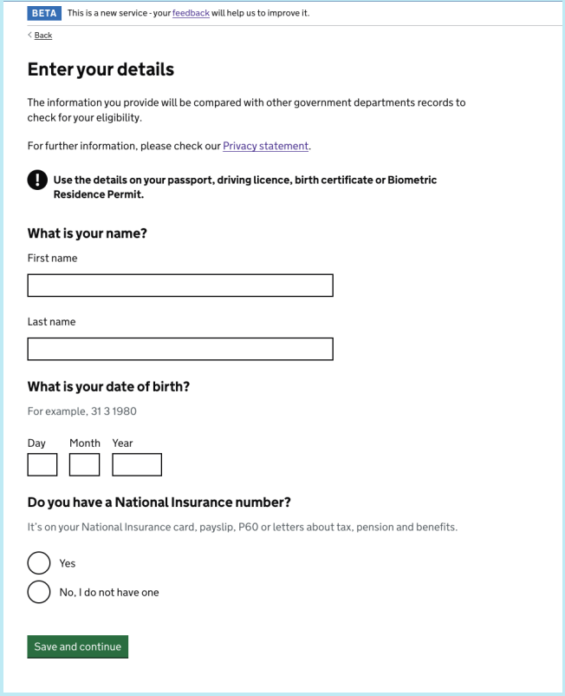
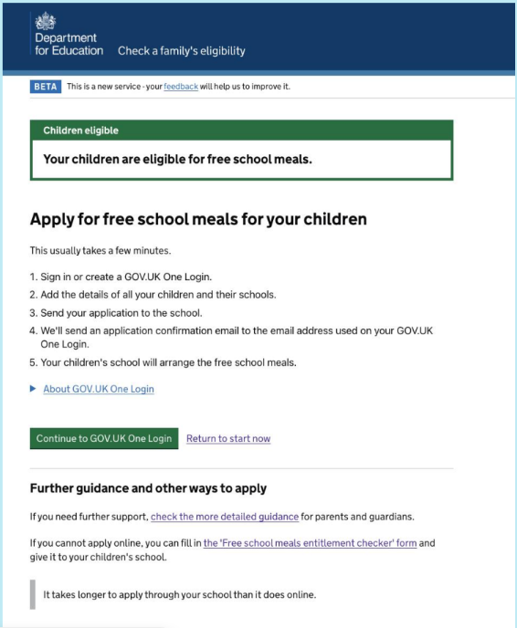
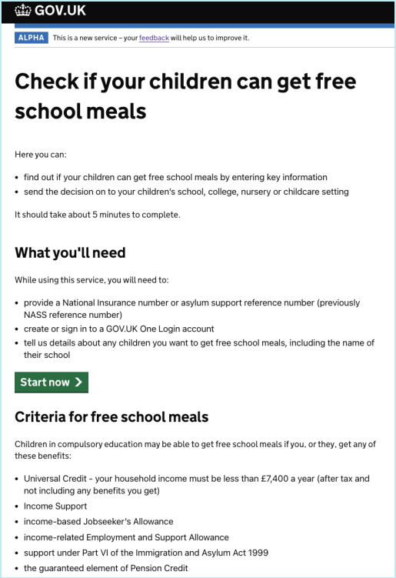
Option 3 – Department for Education (DfE) System.
Notes:
- The DfE are in early stages of developing a national GOV.UK style system which all LA’s will be invited to sign up to.
- Once an LA signs up, parents/carers will be signpost to the national form to submit an application.
- Parents/carers will apply via Hertfordshire website that links to GOV.UK system.
- Application outcomes will be displayed in real time to parent/carers
- Schools will have access to their own DfE login to view application status (also in real time) – No need for SOLERO.
- After seeing a demo, I’m assured this system meets the requirements for parents applying and schools identifying easily application status and therefore HCC are moving forwards with this option.

Slide 7
Progress to Date: Significant Milestones
Jan. 2025
Briefed the business management group on plans to move to new DfE hosted national Free School Meals checking system.
Feb
35 schools signed up as Early Adopters
Mar.–June
Collaborative working:
Schools, LA and DfE developed system fit for purpose
July
User acceptance testing (new applications)
Aug
All currently eligible pupils migrated from old system to new
Sep.–Oct.
Inform all HCC schools (Y3+) of move to new system (Need to sign up)
Nov
Migrated all currently eligible pupils (23,500) to new system
Dec
Fully live from 9th Dec – SOLERO access removed (Y3+)

Slide 8
Smart Survey: - What did schools most want to hear about today?
Making an application
Processing an application
System support
Application status
Data issues
Logging in

Slide 9
Making an application
To apply visit - www.hertfordshire.gov.uk/freeschoolmeals
Applicants routed to new DfE system.
Nursery, reception, years 1 & 2 (UIFSM) –
No change. Schools still view SOLERO for this cohort.

Slide 10
System Demonstration
Fern Williams – Department for Education

Slide 11
Pending applications – Sent for review

Slide 12
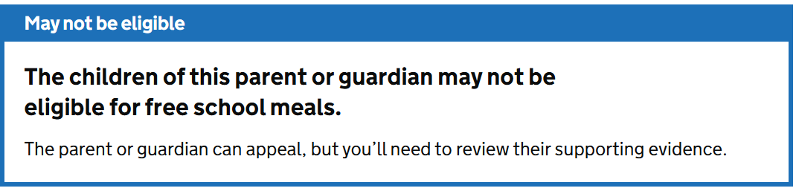
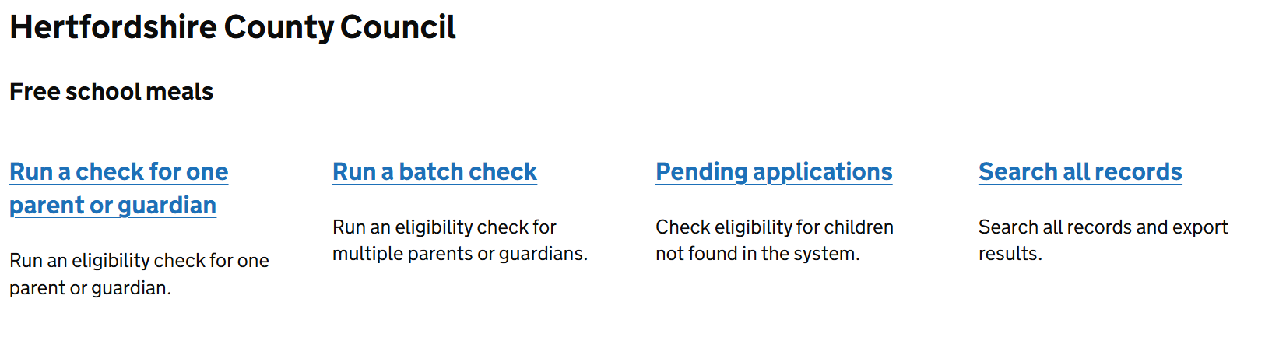






Pending applications – Sent for review
Approximately 7-10% of applications will come back as “not eligible” and will receive this message:
Applicants can still upload proof if they feel they are entitled
Schools will be responsible for checking this proof as part of the application. Additional training guidance and support will be supplied in January.
Schools school regularly check their “pending applications” section for applications waiting for review.

Slide 13
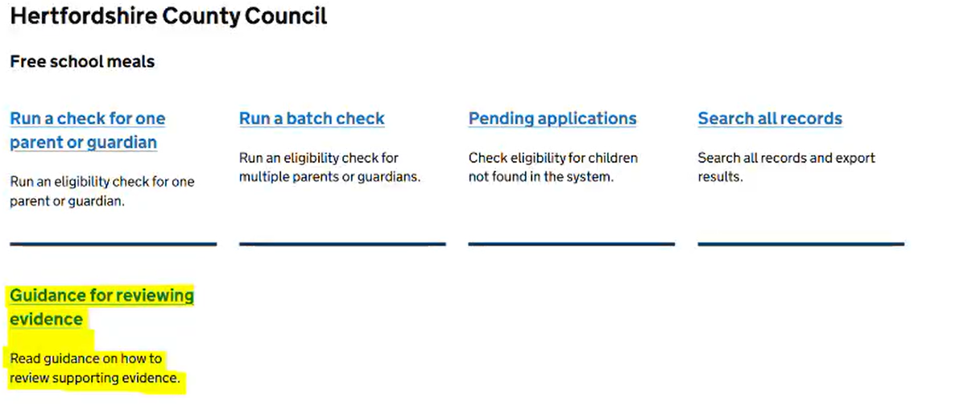
Pending applications – Sent for review cont..
DfE have supplied useful “how to guides” on how to review evidence.

Slide 14
Pending applications – School training
We recognise this is a change for schools
Additional support and training will be supplied in January
Schools will be invited to join the training
We are on hand to help you

Slide 15
What will happen with Year 2’s moving to Year 3?
Schools will be advised of end of year arrangements nearer the time.
As it stands, there will be no change to current guidelines – Applicants MUST re-apply on the new DfE system at the end of the current academic year to ensure continued entitlement.

Slide 16
Supporting schools:
From the 9th December - Customer service centre support will have ceased. This includes the howcanwehelp@hertfordshire.gov.uk or freeschoolmeals@hertfordshire.gov.uk email address.
Schools can either contact
Data queries
CS.enquiries@hertfordshire.gov.uk
System log in and general system issues
ECS.feedback@education.gov.uk

Slide 17
Future system developments
During the development phase, early adopter schools asked for additional functions to be included.
The DfE will continue to work with us on additional options such as:
Provide schools with greater control - We want to provide schools with the ability to make changes to their records when changes occur without needing to contact anyone.
One system for all age groups – The DfE are exploring the option to include Nursery, Reception, Y1 & Y2 pupils on the same system so that schools only have one place to check for low -income families. More info to follow on this.

Slide 18
Next steps:
16th December – Follow up school drop in session
18th December – Mop up migration
From Jan 2026 – Work begins on development opportunities
Jan 26 (Date tbc) – Provide schools with additional walk through/training on how to review proof of benefits.
January 2026 – Archive all currently eligible applications in old system

Slide 19
How will schools be kept informed?
School bulletin articles
Herts Grid for learning
School forums
Schools must check who can access relevant information and share with those who need it.

Slide 20


